Slide 1

AI for Project Management
Smarter Projects:
How AI is Revolutionizing IT Project Management

Slide 2



presentation by
Howard Stone

Slide 3
OVERVIEW
The evolution of IT project management
Explore how modern IT projects demand strict scheduling, budgeting, and security—and how failure can lead to serious risks like data breaches or IP theft.

Slide 4
OVERVIEW
The role of artificial intelligence in project execution
Discover how AI is transforming project workflows, improving accuracy, and helping organizations stay on budget and on time through smarter planning and automation

Slide 5
OVERVIEW
Perspectives from Across the Workforce
Gain insight into how employers, employees, job seekers, and students each view AI’s impact on their roles and the future of work in IT.

Slide 6




EVOLUTION IN AI PROJECT MANAGEMENT

Slide 7
EVOLUTION IN AI PROJECT MANAGEMENT
Baby steps pre-1990’s
Informal, undocumented processes
Whiteboards, paper checklists
Success relied on individual heroics

Slide 8
EVOLUTION IN AI PROJECT MANAGEMENT
Child stage
1990’s- early 2000’s
Introduction of basic digital tools (Excel, email chains)
Waterfall models gain traction
Linear planning, little flexibility

Slide 9
EVOLUTION IN AI PROJECT MANAGEMENT
Teenage stage
Mid 2000’s-2010’s
Agile, Scrum, and iterative development emerge
Collaboration tools (e.g., SharePoint, Basecamp)
Teams start to adapt but still experience growing pains

Slide 10
EVOLUTION IN AI PROJECT MANAGEMENT
adult stage
2010’s - present
Integrated platforms and cloud-based PM tools
AI-enhanced forecasting, automation, and risk management
Strategic leadership, proactive decision-making, and continuous delivery

Slide 11
Research questions
What impact does AI-driven project management have on the roles and responsibilities of IT professionals?
How can Artificial Intelligence enhance project success rates in IT by improving decision-making, resource allocation, and risk management?

Slide 12
As a stakeholder or project manager, has AI helped—or hurt—your ability to do your job?
If you were looking for a job, how does AI impact your job search?
As a student, what are your feelings about AI and your future career in IT?
Research questions

Slide 13
100 CTOs/CIOs (Executive Level)
100 IT Professionals (Technical Team Members)
100 Project Managers & Stakeholders
25 Job Seekers / 25 Students
150 End Users (Non-Technical Employees)
900 surveys sent out
500 surveys returned

Slide 14
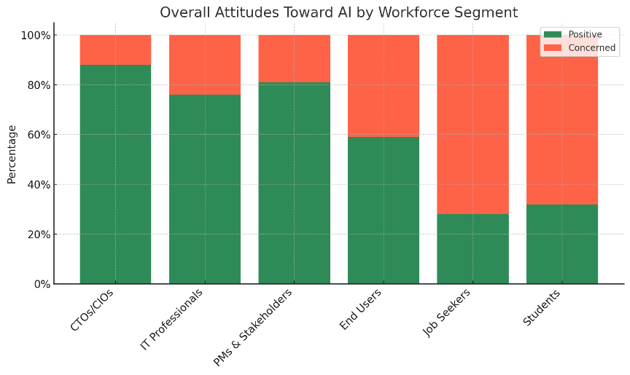
What did the Data Mean

Slide 15
Top reasons for AI
• ⏰ Time Savings
• 🤖 Workflow Automation
• 💲 Cost Reduction
• 📅 Smarter Scheduling
• 📊 Data-Driven Decisions
• ⚠️ Real-Time Risk Detection

Slide 16

⏰ Time Savings
Solution: AI automates status updates, summarizes meeting notes, and sends smart reminders—freeing up hours of manual admin and keeping the team focused on priorities.

Slide 17


🤖 Workflow Automation
Solution: Bots and scripts handle repetitive tasks like ticket triage, approval routing, and reporting. This streamlines workflows and reduces team fatigue.

Slide 18

💲 Cost Reduction
Solution: AI-powered budgeting tools forecast spending patterns and flag cost overruns early in the project, enabling proactive financial control.

Slide 19

📅 Smarter Scheduling
Solution: Machine learning adjusts timelines dynamically based on workload changes, deadlines, and team velocity, making schedules more accurate and realistic.

Slide 20

📊 Data-Driven Decisions
Solution: AI dashboards and predictive analytics convert raw project data into actionable insights—helping leaders make better, faster decisions.

Slide 21

⚠️ Real-Time Risk Detection
Solution: AI identifies risks such as scope creep, resource conflicts, and deadline threats before they escalate—giving project teams time to act.

Slide 22
Top reasons not for AI
• 👷‍♂️ Job Displacement Fears
• 🔒 Data Privacy Concerns
• 🧠 Lack of Technical Skills
• 💸 Unclear ROI
• ⚖️ Ethical or Bias Issues

Slide 23

👷‍♂️ Job Displacement Fears
Concern: AI is automating tasks that used to require people—raising fears about layoffs and reduced career paths for IT professionals.

Slide 24

🔒 Data Privacy Concerns
Concern: AI systems rely heavily on data, but many worry about how securely that data is handled, stored, or potentially misused.

Slide 25
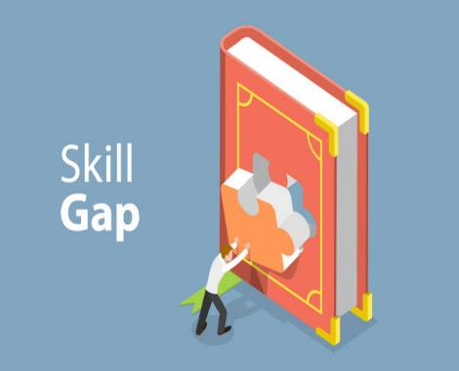
🧠 Lack of Technical Skills
Concern: Many workers feel unprepared for AI integration, with a growing skills gap between existing roles and future needs.

Slide 26

💸 Unclear ROI
Concern: Organizations hesitate to invest in AI without guaranteed returns—especially when upfront costs and long-term value are hard to measure.

Slide 27
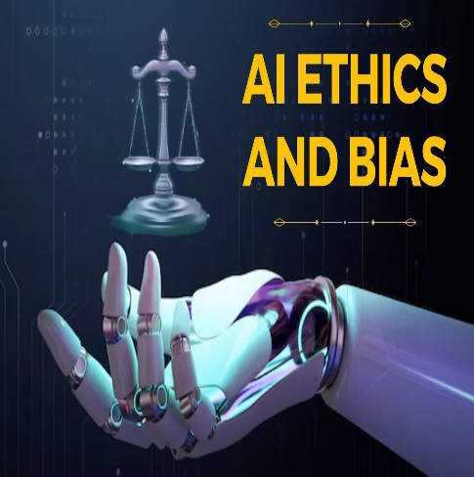
⚖️ Ethical or Bias Issues
Concern: AI decisions can reflect hidden biases or operate without transparency, making it hard to ensure fairness or accountability.

Slide 28

conclusion

Slide 29
“AI took the grunt work off my plate—but it also made me realize I need to keep learning to stay relevant.” — Samira K., IT Systems Analyst
“It’s like working with a superpowered assistant. I still make the calls, but AI makes the data clearer.” — Jared M., Project Coordinator
“Honestly, I’m nervous. What if next year, my role is considered ‘automatable’?” — Elena D., QA Specialist

Slide 30
“For us, it’s not about replacing people—it’s about reallocating talent to where they make the biggest impact.” — Marcos L., CIO at NexTech Solutions
“We implemented AI tools to cut down delays. What we didn’t expect was better morale—people liked not being stuck in spreadsheets.” — Denise P., IT Operations Manager
“AI gives us scale. One project manager can now oversee five initiatives instead of two.” — Brian F., Director of Digital Transformation

Slide 31
“It’s frustrating when AI screens my resume before a human ever sees it.” — Reggie T., Recent IT Graduate
“I use ChatGPT to prep for interviews. It’s weird, but also kind of genius.” — Lana R., Freelance Developer
“AI is both the gatekeeper and the opportunity. You just have to understand how to play the game.” — Andre M., Transitioning Systems Admin

Slide 32
references
References
Project Management Institute. (2021). A Guide to the Project Management Body of Knowledge (PMBOK® Guide) (7th ed.).
CIO.com. (2023). Top Reasons IT Projects Fail.
Harvard Business Review. (2022). How AI is Changing Project Management.
TechRepublic. (2023). AI Tools Transforming IT Project Success.

Slide 33
Visual source
Visual Sources
All people-style images were created using OpenAI image tools.
Stock photos were sourced from Microsoft stock and Google Search under fair use for educational purposes.

Slide 34
disclaimer
Disclaimer
Note: No actual survey was conducted. The data presented (e.g., "900 surveys sent out, 500 returned") was AI-generated for illustrative purposes only. The insights and research content remain grounded in current industry practices and expert perspectives.

